Slide 1
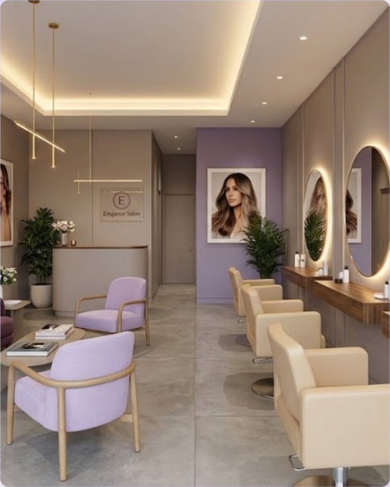
ELEGANCE SALON
Salon Management System
Online booking, client records, staff, stock and payments in one PHP + MySQL application
Supervisor: Miss Anumta Alam | Batch 2512E1
Ayesha Farooq · Ibra Ali · Muhammad Qasim · Wania Kaleem
Notes:
Introduce the project: Elegance Salon, a beauty salon that needed a single system for appointments, clients, staff, inventory and payments. Built with plain PHP and MySQL.

Slide 2






Agenda
01
02
03
Problem and goals
Features by role
Architecture
04
05
06
Booking engine
Database and ER diagram
Security and next steps
Notes:
Six parts: why we built it, who uses it, how it is built, the booking algorithm, the data model, and security plus future work.

Slide 3
From manual juggling to one system
The challenge
Our solution
Appointments managed by hand, risk of double booking
Client details and history scattered
Stock runs out without warning
No view of sales, busy hours or staff performance
Online booking with live free times and a reference number
Central client database with service history
Inventory with low-stock alerts and purchase orders
Reports, commission tracking, invoices and reminders
Notes:
The spec from Aptech lists these pain points: appointments, inventory and client records. Each maps to a module.

Slide 4




The system at a glance
12
13
3
0
database tables
admin modules
user roles
frameworks or packages
Public booking
People
Operations
Automation
Services, live slots, manage, .ics
Clients, stylists, shifts, commission
Stock, payments, invoices, reports
Email log and daily reminders
Notes:
Numbers come straight from the code base: 12 tables in the SQL file, 13 modules in the admin sidebar, 3 roles in role_modules(). No framework or Composer.

Slide 5




Who can do what
Client
Receptionist
Stylist
Admin
No account needed
7 modules
3 modules, own data
All 13 modules
Browse services
Book online
Change or cancel
Send feedback
Appointments, calendar
Clients
Payments, invoices
Inventory, feedback
Dashboard
Own appointments
Own calendar
Update status
Services and staff
Accounts and settings
Reports, notifications
Everything above
Notes:
Roles are enforced by role_modules() and require_module() on every admin page. Stylists are limited to their own appointments by is_stylist().

Slide 6
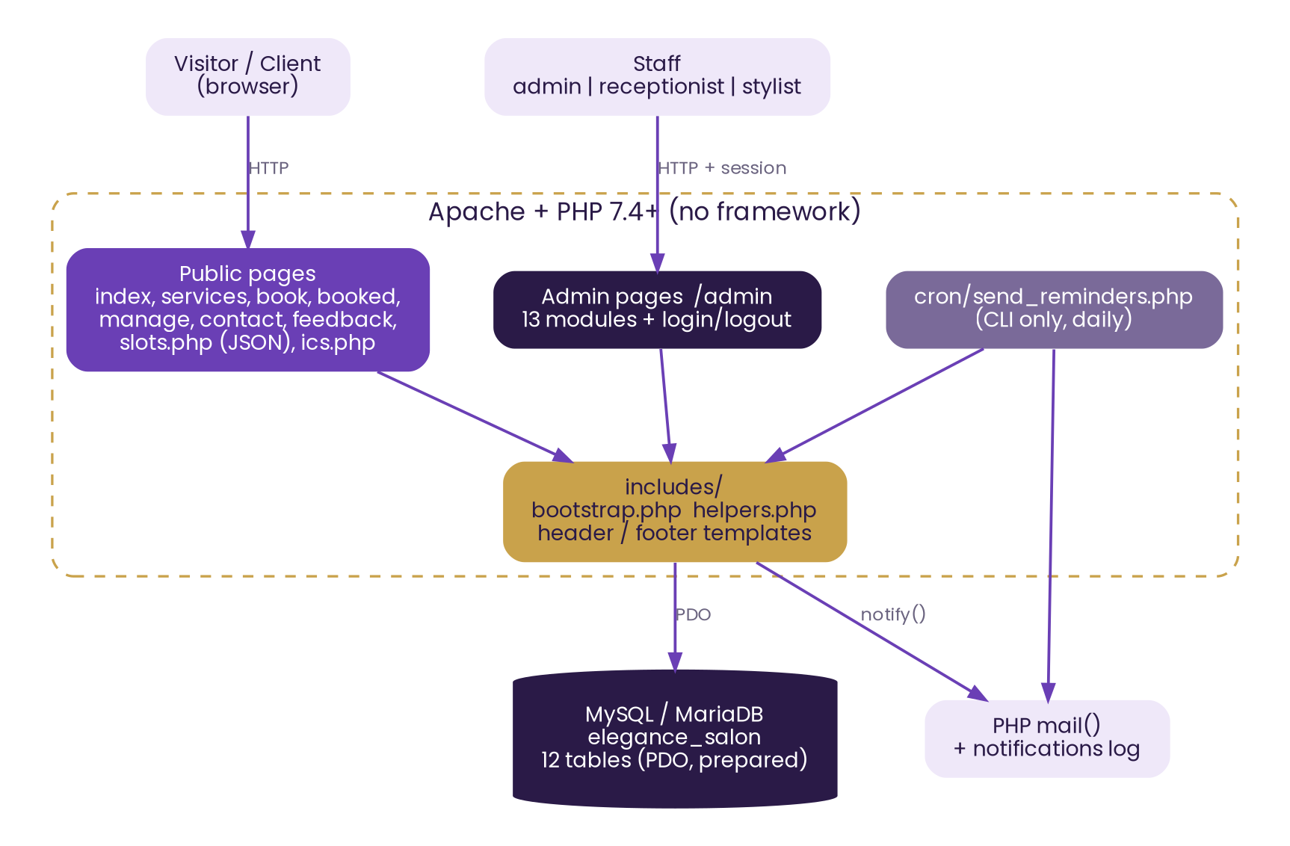
Architecture
Page-per-file PHP
Each page handles its request, then renders HTML. Shared logic lives in includes/.
PDO and prepared statements
One database layer: q(), fetch_all(), fetch_one().
One AJAX endpoint
slots.php returns free times as JSON for the booking form.
Cron job
Daily reminder emails, CLI only.
Notes:
Deliberately simple: runs on any XAMPP. bootstrap.php starts the session, loads helpers and sets security headers.

Slide 7
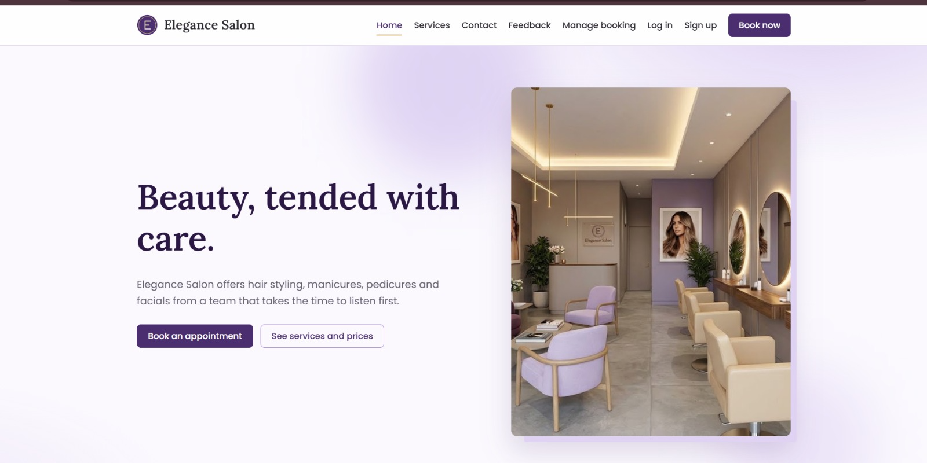
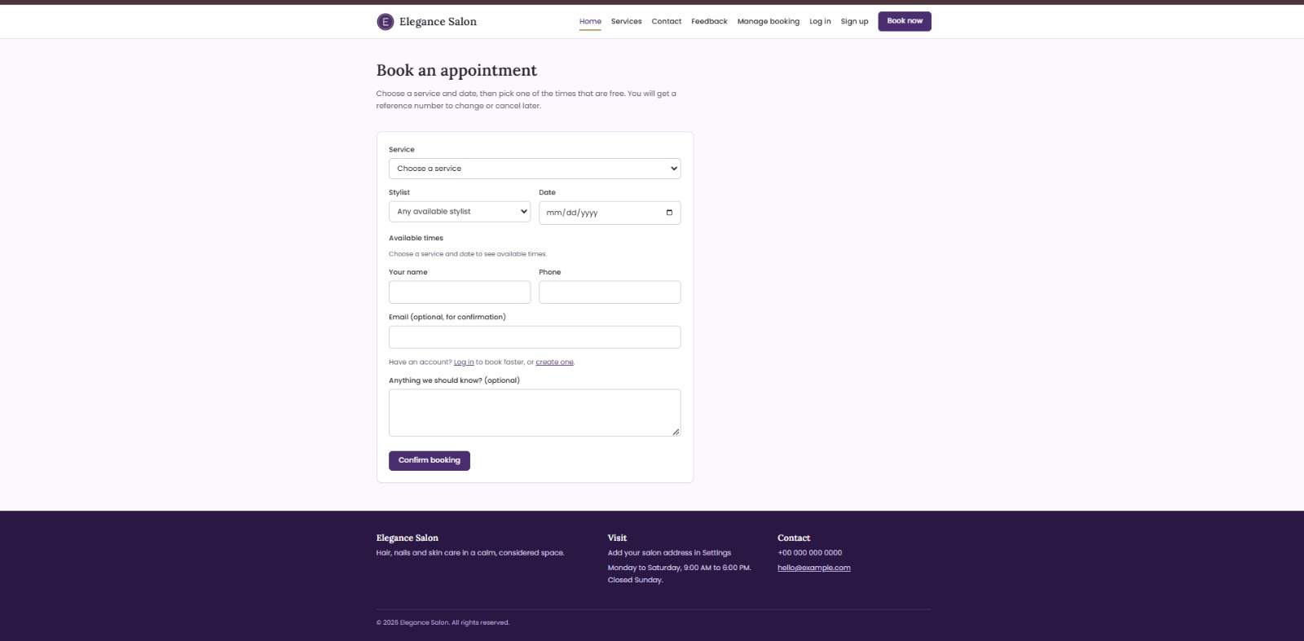
The public website
Home: clear call to action
Book: service, stylist, date, time
Hero, popular services, team, Book now in every header.
Free times load live. Account not required. Reference number on success.
Also: Services and prices · Contact · Feedback · Manage booking (reference + phone) · Add to calendar (.ics)
Notes:
Screens are from the running site. Manage booking lets a client change or cancel with the reference and phone.

Slide 8
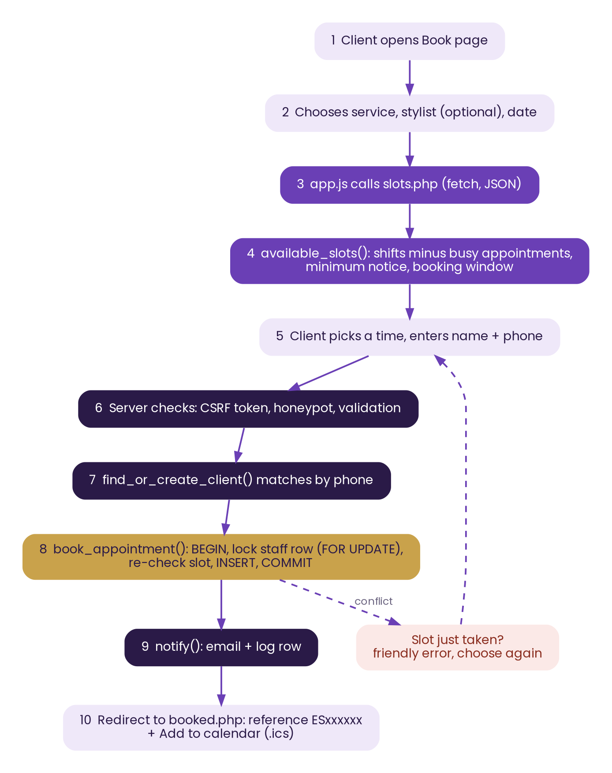



Booking engine: from click to confirmation
Live availability
app.js calls slots.php; no page reload.
No double booking
Transaction plus row lock on the stylist re-checks the slot before INSERT.
Reference + calendar
ES + 6 characters, and an .ics file for the client’s calendar.
Notes:
If two clients submit the same slot at once, the row lock serialises them; the second gets a friendly message to pick another time.

Slide 9
How free times are calculated
Example: one stylist, 09:00 to 18:00, 60-minute service, 30-minute step, one booked appointment 11:00 to 12:00
Busy
09:00
10:00
11:00
12:00
13:00
14:00
15:00
16:00
17:00
Free start times: 09:00 09:30 10:00 | 12:00 12:30 … 17:00 Rejected: 10:30, 11:00, 11:30 (overlap)
1
Shift
2
Step
3
Filter
4
Overlap
Read the stylist’s hours for that weekday
Walk the day in slot_interval minutes; service must fit before the end
Drop times before now + minimum notice
Remove any t where t < busy_end and t + duration > busy_start
Notes:
This is available_slots() and staff_slots() in helpers.php. For Any available stylist the first free stylist is attached to each time.

Slide 10
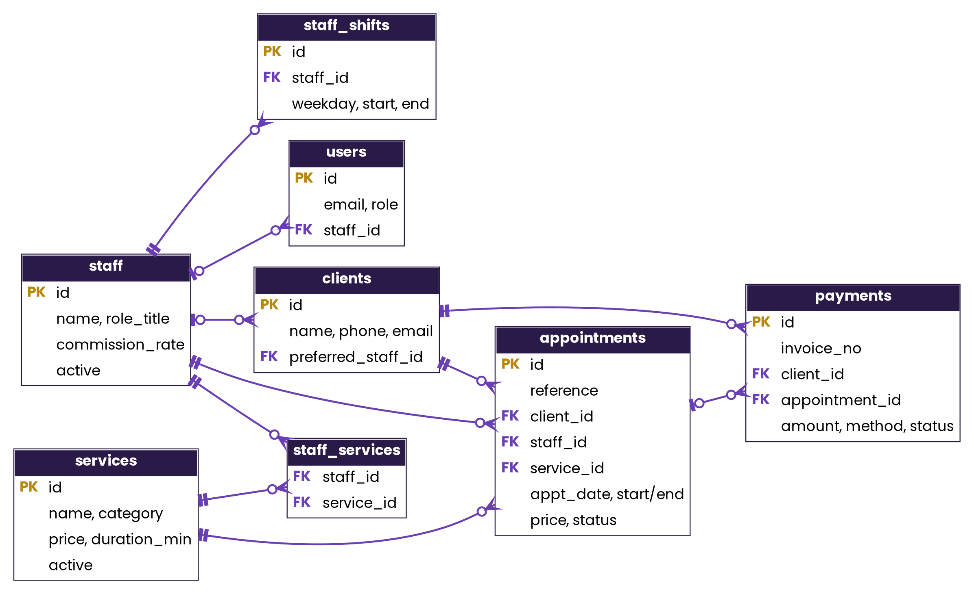
Database design: 12 tables
appointments
Central table: client + stylist + service, with copied price and end time
staff ↔ services
Many-to-many through staff_services; weekly hours in staff_shifts
payments
Linked to client and, optionally, an appointment (walk-ins allowed)
Standalone
settings, inventory_items, feedback, notifications (not shown)
Notes:
Full ER diagram is in the Developer Guide and as a separate PNG. Foreign keys cascade on link tables and restrict on appointments so history stays intact.

Slide 11
Code base: where the work is
~3,900
lines of PHP, CSS and JS in 40 files
582
lines in helpers.php: the shared engine
100%
queries use prepared statements
Notes:
Counts are from wc -l on the delivered source: admin 1,837, public 824, includes 773, CSS 307, JS 131.

Slide 12




Security by design
SQL injection
XSS
CSRF
Prepared statements everywhere
All output escaped with e()
Token in every form, checked on POST
Passwords
Brute force
Access control
password_hash, 10+ characters
Lock after 5 login or 8 lookup failures
Role check on every admin page
Notes:
Also: session id regenerated on login, HttpOnly and SameSite cookies, honeypot fields, blocked includes/cron/database folders, validated uploads, debug off by default.

Slide 13
Role-based access matrix
Module | Admin | Receptionist | Stylist
Dashboard | Yes | Yes | Own
Appointments | Yes | Yes | Own
Calendar | Yes | Yes | Own
Clients | Yes | Yes | -
Inventory | Yes | Yes | -
Payments | Yes | Yes | -
Feedback | Yes | Yes | -
Services, Staff | Yes | - | -
Reports, Notifications | Yes | - | -
Accounts, Settings | Yes | - | -
How it is enforced
role_modules() lists modules per role
require_module() guards each page
The sidebar uses the same can() check
Stylist queries add staff_id = own
Notes:
Unauthorised users see a 403 Not allowed page; guests are redirected to the login page.

Slide 14
Design decisions and trade-offs
Two clients, one slot
Transaction + SELECT … FOR UPDATE on the stylist row, slot re-checked before INSERT
Service price changes later
Price and end time copied onto the appointment at booking
Clients without accounts
Match by phone number; manage with reference + phone
Stylist privacy
Own-row checks (own_check) on every appointment action
Easy installation
No framework; check.php and setup.php guide the first run
Notes:
These are the choices a reviewer is likely to ask about; each is visible in helpers.php.

Slide 15
Limits today, roadmap next
Current limits
Roadmap
Calendar sync is a one-way .ics file
One service per appointment
No online card payment; staff record payments
Email only, no SMS
Staff password reset done by the admin
SMTP mail and SMS reminders
Payment gateway and booking deposits
Multi-service appointments
Client accounts and loyalty points
Email-token password reset, audit log
Notes:
Limits are listed honestly in the README as well. The roadmap items need external services (mail, SMS, payments).

Slide 16
Thank you
Questions and live demo
Demo path: Book now → Confirm → Manage booking → Staff sign in → Appointments → Payments → Reports
Ayesha Farooq · Ibra Ali · Muhammad Qasim · Wania Kaleem
Notes:
Suggested live demo order is on the slide.

